Slide 1
INTRODUCTION TO PNEUMATICS
Thanks to Ian Mackenzie

Slide 2
Agenda
Introduction to Pneumatics
Pneumatic Components
Pneumatic Mechanisms
Resources

Slide 3
Pneumatic Principles
compressor
solenoid valve
hose
reservoir tank

Slide 4
Pneumatic Principles
compressor
solenoid valve
hose
reservoir tank

Slide 5
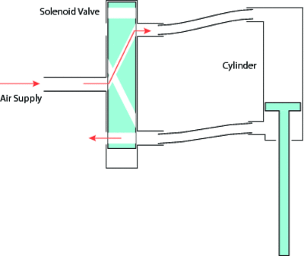
Pneumatic Principles

Slide 6
Why Use Pneumatics?
Weight
Much lighter than motors (as long as several used)
Simple
Much easier to mount than motors
Much simpler and more durable than rack and pinion
More rugged
Cylinders can be stalled indefinitely without damage
Resistant to impacts
Disadvantage: All the way in or all the way out

Slide 7
Pneumatics Board

Slide 8
Pneumatic Components - compressor
Generates pressure of 120 psi
Always run off relay module, in forward
Do not use to generate a vacuum!

Slide 9
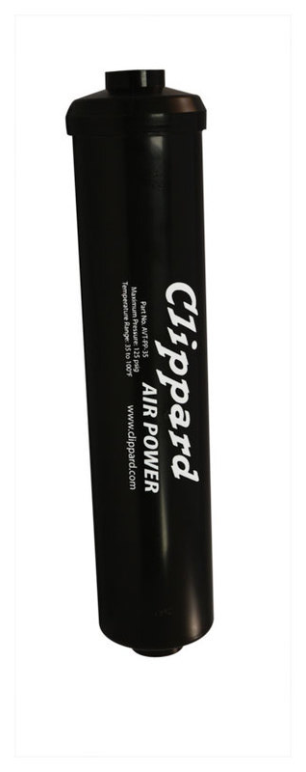
Pneumatic Components - RESERVOIR
Store compressed air up to 120 psi
Top up before each match
Slow leaks can decrease pressure between pit and field
Tether robot beside field to top up pneumatics

Slide 10
Pneumatic Components - REGULATOR
Allows air from reservoirs to flow to rest of pneumatic system
Limits pressure in valves, cylinders to 60 psi

Slide 11
Pneumatic Components - Pressure Sensor
Detect pressure in pneumatic system
Indicate whether system is above or below a set pressure
Can be calibrated
Pressure below 105 psi: compressor on
Pressure above 115 psi: compressor off

Slide 12
Pneumatic Components - Solenoids
electromagnetic coil
rod
iron core
spring

Slide 13
Pneumatic Components - Single Solenoid
When energized, cylinder goes to one state
When de-energized, cylinder always returns to rest state
When power is cut at the end of the match, cylinder will return to rest state
Each valve powered by one relay module (only in forward)

Slide 14
Pneumatic Components - Double Solenoid
One solenoid pulsed to move cylinder one way, other solenoid pulsed to move cylinder the other way
Results unpredictable if both pulsed
Valve will stay in either state when neither solenoid energized

Slide 15
Pneumatic Components - Cylinders
Force = Pressure X Area
2” diameter piston
Area = 3.14 X 1² = 3.14 in²
Pressure = 60 psi
3.14 in² X 60 psi = 188 lbs
Force while extending greater than while retracting
Main decisions: Length and diameter
Diameter based on required force
Larger diameter: more force, but more air

Slide 16
Pneumatic Components – Cylinder TIPS
If you need the piston to stay extended or retracted, add a mechanical latch
Be careful to ensure the piston rod cannot get bent
Hard to get locknuts/lock washers in large sizes, so nuts on pistons likely to come loose

Slide 17
Pneumatic Components – Flow Controls
Regulate flow of air into and out of a cylinder
Used to control speed of a pneumatic cylinder
If used, attach directly to cylinder (only one end needed)
Seems to regulate air flowing in both directions, but one direction is restricted a little more

Slide 18
Pneumatic Components – Fittings
Put Teflon tape on all threads to ensure a good seal
Do not put tape on first two threads, as it may come loose and clog up a valve
Tubing attached simply by pushing it into connector
If you have a leak, try cutting off the last couple centimeters of tubing; if it is damaged, it will not seal properly
To detect leaks, put soapy water on suspect connections and watch for bubbling

Slide 19
Pneumatic Components – Exhaust Valve
Use to release pressure (especially at the end of a match)
Useful if you need to be able to release a grabber after a match is over

Slide 20
Pneumatic Mechanisms - Linear Motion
Much simpler, easier, more durable than rack and pinion
Can maintain constant force
wires from relay
A B
Single solenoid valve
P
regulator
reservoir
compressor

Slide 21
Pneumatic Mechanisms - Short Rotation
Arm joints
Grabbers

Slide 22
Pneumatic Mechanisms - Constant Force
Gear shift
Brake
Critical piston
Non-critical piston
double solenoid valve
single solenoid valve
A B
A B
P
P
tee fitting
regulator
A B
double solenoid valve
pressure sensors
P
reservoir
compressor

Slide 23
Pneumatic RESOURCES
www.chiefdelphi.com/forums/papers.php
White papers on many topics
www.chiefdelphi.com
Very active and helpful FIRST forums

